Slide 1
Team Compaction
좌우꾸와쒼
E-Mail : erosbryant@dankook.ac.kr
발표: 강상우
E-Mail : aarom416@naver.com

Slide 2
Contents
CleanupCompaction()
DoCompactionWork() Detail
How data is put into the sstable?
Data code flow

Slide 3
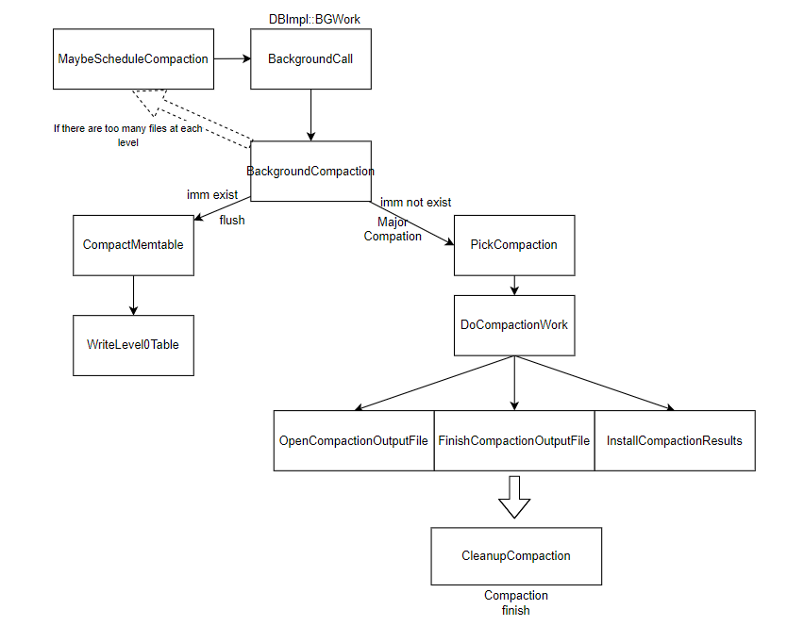
Overall Code Flow:

Slide 4
Overall Code Flow: CleanupCompaction()
CleanupCompaction
Remove abnormal sstables

Slide 5
How data is put into the sstable?
?

Slide 6
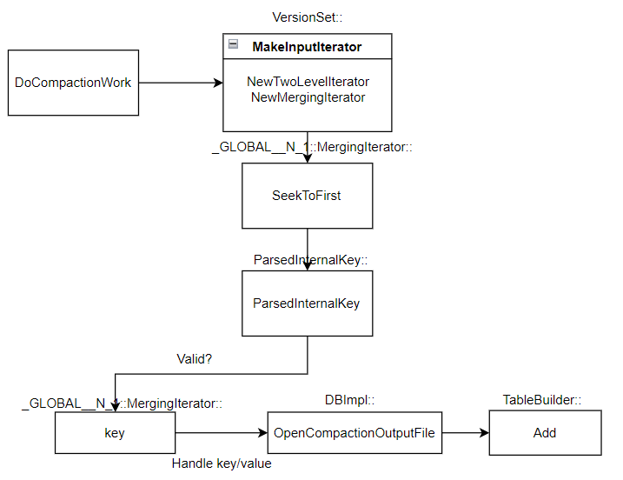
DoCompactionWork() Detail: Data Code Flow

Slide 7
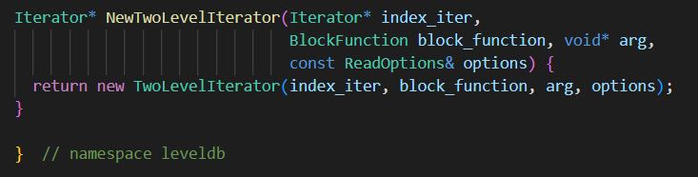
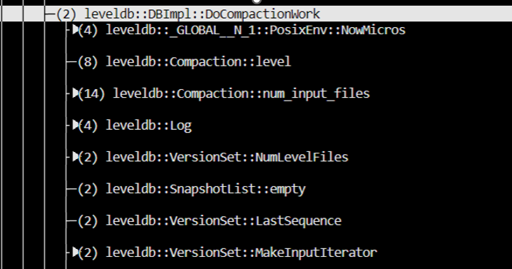
DoCompactionWork() Detail: MakeInputIterator()
NewTwoLevelIterator
Index iter and data iter
Build data iter
NewMergingIterator
Build iter at each level
=> The inside of the keys is orderly

Slide 8
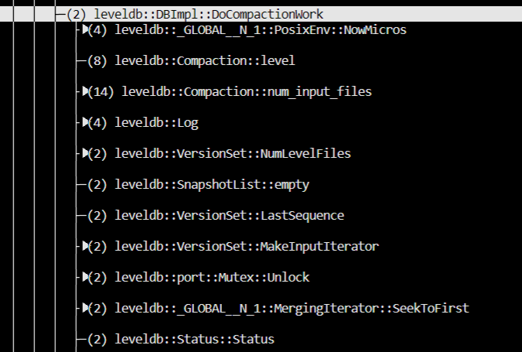
DoCompactionWork() Detail: SeekToFirst()
SeekToFirst
Position at the first key

Slide 9
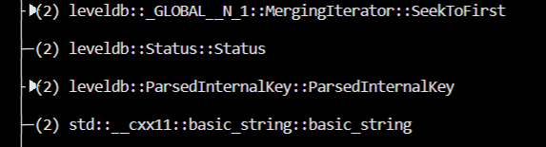
DoCompactionWork() Detail: ParsedInternalKey()
ParsedInternalKey
Internalkey parsing

Slide 10
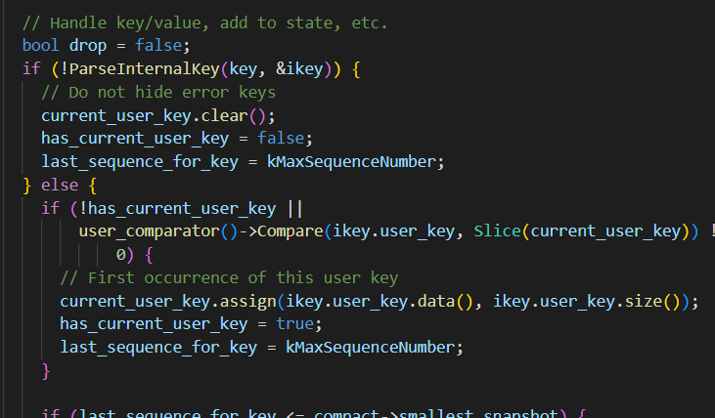
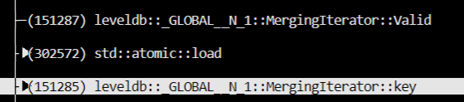
DoCompactionWork() Detail: MergingIterator::key()
MergingIterator::key()
If valid, save key
Handle key/value

Slide 11
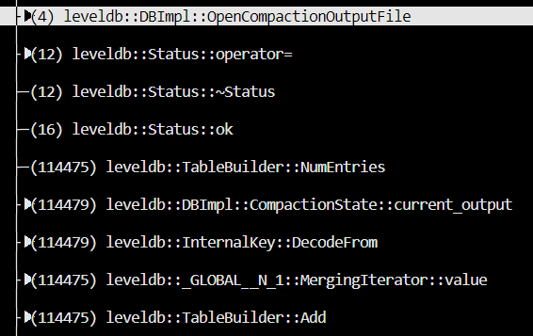
DoCompactionWork() Detail: Add key/value to sstable
OpenCompactionOutputFile
Create new sstable
Add
Add key/value to ssatble

Slide 12
Thank you

